Slide 1
Assignment
24-04-2025

Slide 2
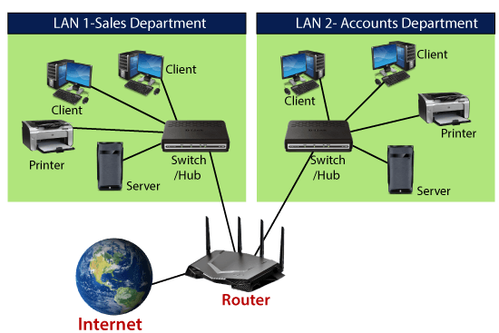
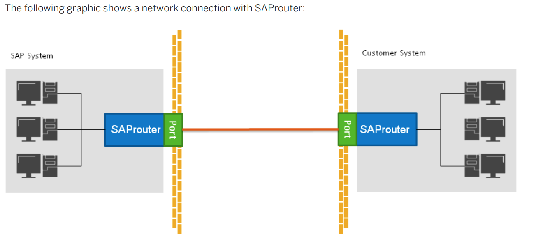
🧭 What is a Physical Router?
A Physical Router is a hardware device that operates at Layer 3 of the OSI model (Network Layer). It's commonly used in homes, offices, and data centers to route IP traffic between networks.
🔐 What is SAProuter?
SAProuter is not a physical device, but a software tool provided by SAP. It acts as an application-layer proxy to manage secure communications between SAP systems or between a customer system and SAP Support (OSS).

Slide 3
Physical Router vs SAProuter
Aspect | Physical Router | SAProuter
Type | Network Hardware Device | SAP Software Component (Executable)
Purpose | Routes network packets between networks (Layer 3) | Controls and secures SAP-related communication
Functionality | Handles IP routing, NAT, firewall rules, etc. | Works like an application-level proxy for SAP traffic
Location | Network layer (hardware level) | Runs on OS level where SAP system or DMZ is hosted
Security Role | Basic firewall or gateway | Filters & logs SAP communication based on route string
Ports Handled | TCP/IP ports, all types of traffic | Typically port 3299 for SAP

Slide 4
Functionality of SAProuter
SAProuter is an intermediate server (proxy) that controls access and secures communication between SAP systems.
Major Functionalities:
Secure Communication
Access Control via saprouttab
Logging and Monitoring
SAP OSS Connectivity
Use Cases:
SAP GUI secure access
Gateway between SAP systems and Solution Manager
Cloud connectivity
saprouttab - routing permission table to control which systems are allowed to communicate with each other via the SAProuter.

Slide 5
Where to Maintain SAProuter
Deployment Location:
SAProuter should be installed in the DMZ (Demilitarized Zone) of a customer’s network.
This allows controlled external access while maintaining internal security.
Why DMZ?
Buffer zone between internal networks and external access
Prevents direct access from the internet to SAP systems
Requirements:
Lightweight server with static IP
Open firewall port 3299
saprouter & saprouttab configured
Tip: Register SAProuter using OSS Note 30289 and maintain a valid certificate.

Slide 6

Real-Time BASIS Issues: RFC Failures
Issue: RFC (Remote Function Call) Connection Failure
Symptoms:
SM59 connection test fails
Timeout, logon failure, or hostname not reachable errors
Root Causes:
Incorrect hostname/system number
Expired/deleted RFC user credentials
SNC mismatch
Case Scenario:
A trusted RFC connection is configured between DEV and QA. Transport fails in QA. Investigation reveals the RFC user was deleted in QA.

Slide 7
Continued…
Resolution:
Recreate user with required roles
Update credentials in SM59
Re-test the connection
Tools:
SM59 - RFC (Remote Function Call) connections
ST22 – Dump Analysis
SU01 – User Maintenance
SCC4 – Client Creation

Slide 8

Real-Time BASIS Issues: STMS Queue Issues
Issue: Transport Queue Not Updating
Symptoms:
New transports do not appear in the import queue
Queue stuck or shows RFC error
Root Causes:
RFC between domain controller and system is broken
DOMAIN.CFG file is outdated or unsynced
Case Scenario:
A developer releases a transport in DEV, but it doesn’t show up in QA queue.
STMS → Overview → Systems shows red RFC light.

Slide 9
Continued…
Resolution:
Check TMS RFC in SM59
Sync domain configuration from domain controller
Use STMS → Overview → Systems → Configuration Check
Tools:
SM59: RFC(Remote function call) Connections
STMS: SAP Transport Management System

Slide 10

Real-Time BASIS Issues - SAProuter Failure
Case Scenario:
SAP support attempts to log in during incident handling but fails. Root cause is SAProuter not restarted after server reboot.
Resolution:
Restart SAProuter using: saprouter -r
Register routes with: saprouter -n -R <path>
Check logs and route entries
Issue: SAP Cannot Connect to Customer System
Symptoms:
SAP support is unable to log in for remote service
SAProuter logs show denied access
Root Causes:
SAProuter not running
Firewall blocking port 3299
Invalid or expired route permission file (saprouttab)

Slide 11

Real-Time BASIS Issues: Transport Failures
Issue: Transport Import Failure (RC=12 or RC=8)
Symptoms:
Import fails in QA/PROD with error logs
Objects missing, syntax errors, or disk space issues
Root Causes:
Full file system
Syntax errors in ABAP code
Missing transport logs or cofiles
Case Scenario:
A transport fails in PROD due to lack of space in /usr/sap/trans. TP logs show return code 12.

Slide 12
Continued…
Resolution:
Clear unnecessary logs, transport files
Extend filesystem or move files to archive
Re-import transport using STMS_IMPORT
Tools:
STMS_IMPORT – Import Transport Requests
AL11 – SAP Directory Viewer
DF - (Likely means Data Browser shortcut, possibly SE16/SE16N)
TP – Transport Control Program (Command Line Tool)
SE01 – Transport Organizer

Slide 13

Conclusion & Best Practices
Key Takeaways:
SAProuter secures SAP system communication.
Place SAProuter in DMZ with valid logs/routes.
RFC/STMS issues are fixable with configuration checks.
Best Practices:
Use ST22, SM59, STMS
Check saprouttab
Alerting for TMS/RFC failures.

Slide 14
Thank you
Presented by S. Vinish

